Slide 1
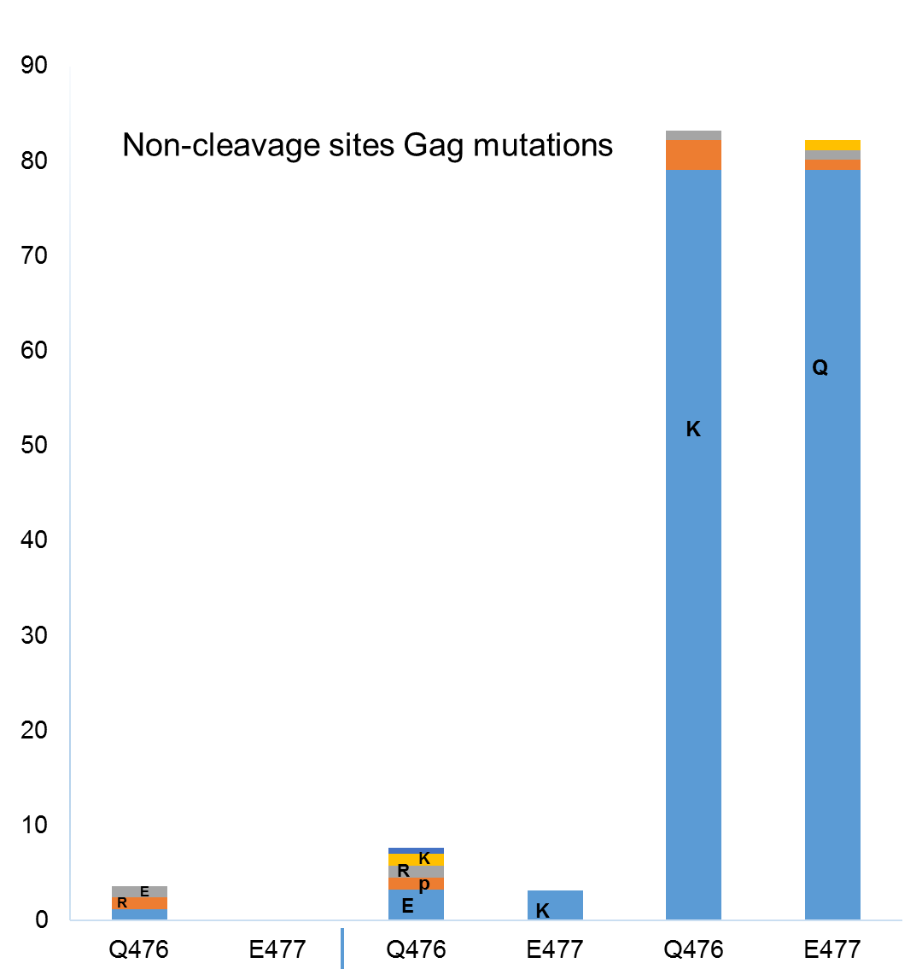



Viral C-Terminal region P7 – P6^{gag} Gag polymorphisms and Protease drug resistance mutations profile in HIV-1 infected patients failing Protease Inhibitors combination therapy.
P ˂ 0.0001
Teto. G, Takou K.D., Fokam J. Dambaya B, Nka A.L. Maria-Mercedes Santoro, Vittorio Colizzi, Carlo-Federico Perno and Ndjolo Alexis
Introduction
HIV Gag mutations was reported to confer PI resistance in B subtypes but little is known about non-B. Understanding the role of P7–P6^{gag} and characterize relevant mutational patterns, could help to reduce failures to PI
Material and methods
We conducted at CIRCB a cross-sectional study on 334 individuals (96 on PI). Resistance mutations (RMs) were analyzed in the protease using Stanford algorithm. Mutations were identified in P7–P6^{gag} cleavage sites(CS) (P7/P1 and P1/P6^{gag}) and non-CS of each sequence using HXB2 and BioEdit. Each Gag sequence was analyzed for the presence of P7–P6^{gag} RMs known or not to be associated with resistance to PIs. Samples containing a mixture of wild type and mutant were scored as mutants. Statistical analysis was performed using GraphPad Prism 6 and p ≤ 0.05 was considered significant.
Results
We compared PI exposed patients to not exposed in P7–P6^{gag} CS and non-CS. In CS we found RMs given as exposed/not exposed frequencies: I437V 0%/0.84%; L449P 73.9%/ 80%; P453L 9.37%/3.36% with the respective p 0.861;0.675;0.04 in P7/P1 CS for the first RM and P1/P6^{gag} CS for the others. In non-CS, we found V467E 84.37%/92.47% (p=0.607) and two new mutations with high entropies Q476K 79.16%/0.84% and E477Q 79.16%/0% (p< 0.0001). Among the 96 (44.31% men, Mean age [IR]=41.21±12.66 [7-70] yrs.), 76 were failing PI with RMs (38.63% M46I, 7.95% I47IV/V/A, 4.54% I50L, 12.5% I54IM/M, 14.77% L76V, 4.54%, V32F11.36% V82S/T/A/F, 21.59% I84V and 5.68% L90M). We found the prevalence of RMs in P7– P6^{gag} in patients with PI-RMs as compared to those with no PI-RMs.
Mutations in term of PI-RMs/no PI-RMs were: P453L 55.5%/44.4%; Q476K 43%/55.26%; E477Q 42.10%/53.94% all with p>0.05. No P7–P6^{gag} RMs was linked to a particular subtype: CRF02_AG (63%), G (4%), F2(4%), A (17%), D (2.63%), CRF11_cpx (11.3%) or CRF09_cpx (1.3%) (p≥0.05).
Discussion
We revealed, two new, not yet described, potentially important mutations Q476K, E477Q in P7–P6^{gag} non-CS of non-B Gag, that could have clinical implications. They showed no Subtypes or PI-RMs impact. However, further phenotypic analyses and clinical correlates of drug failure will be needed before such information is suitable for amending existing resistance algorithms.
Figures and Tables
Figure 1: Study participants
Figure 2:: Non-cleavage site Gag mutations of patients on second line PI combination therapy
Figure 3: Amino acids’ residues entropy of patients on second line therapy
Table 1:Prevalence of previous and novel C-Terminal (P7-P6) Gag
mutations associated with PI exposure and failure
Table 2: Prevalence of Gag mutations associated to protease drug resistance mutations among those exposed to PI
334 patients
96 on PI
44.31% men
Mean age [IR] = 41.21 ± 12.66 yrs [7-70]
Percentage of patients
Mutat- ions | Prot- eins | Cleavage site | Not Exposed to PI | Exposed to PI | p-Value | OR | 95% CI
A431V | P7 | P7/P1 | / | / | / | / | /
I437V | P1 | P7/P1 | 0.84% (2/238) | 0% (0/96) | 0.861 | 0.806 | 0.0723-9.001
L449P | P6gag | P1/P6gag | 80% (191/238) | 73.9%(71/96) | 0.675 | 1.085 | 0.756-1.557
P453L | P6gag | P1/P6gag | 3.36% (8/238) | 9.37%(9/96) | 0.040 | 0.358 | 0.1344-0.956
Q476K | P6gag | non-CS | 0.84% (2/238) | 79.16%(76/96) | ˂ 0.0001 | 0.0106 | 0.0026-0.0441
E477Q V467E | P6gag P6gag | non-CS non-CS | 0% (0/238) 92.43% (220/238) | 79.16%(76/96) 84.37% (81/96) | ˂ 0.0001 0.607 | 0.0053 1.095 | 0.0007-0.0387 0.773-1.551
76 failing PI combination treatment
34(44.73%) showing on Protease, majors and ?? accessories PI drug 55.27% resistance mutations
Percentage of patients
P ˂ 0.0001
2NRTI+ 1P
Mutations | PI-DRM (#,&) | NO PI-DRM (#,&) | Subtypes (%) | P-Value
Q476K | 33/76 (43%) | 42/76 (55.26%) | CRF02_AG (63%); G (4%); F2 (4%); A (17%); D (1.3%); CRF11_cpx (1.3%) CRF09_cpx(1.3%). | 0.133
E477Q | 32/76(42.10%) | 41/76 (53.94) | CRF02_AG (60%); G (4%); F2 (4%); A (17%); D(2.63%); CRF11_cpx (1.3%); CRF09_cpx(1.3%). | 0.250
P453L | 5/9 (55.5%) | 4/9 (44.4%) | CRF02_AG (66.6%); G (22.2%); CRF09_cpx (11.1%) | 0.92
NAIVE
2NRTI + 1NNRTI
We revealed, two new, not yet described, potentially important mutations Q476K, E477Q in P7–P6^{gag} non-CS of non-B HIV Gag, that could have clinical implications.
CIRCB
PRESENTED AT THE 23RD INTERNATIONAL AIDS CONFERENCE (AIDS 2020) | 6-10 JULY 2020

